Slide 1
Internet of Things
Module 6, Lesson 7:
Azure Notification Hub

Slide 2
Topics
Push Notifications
Push Notification Systems
Azure Notification Hub

Slide 3
Objectives
By the end of this lesson you should be able to:
Understand what a push notification is
Know the basic mechanism of Push Notification Systems
Understand limitations and challenges of PNS
Explain and understand basic overview of Notification Hub

Slide 4
What are Push Notifications?
Notify users as events occur through smartphones and tablets
Allows applications to provide fresh information without having to be constantly active
Displays notification outside of its normal user interface
Allows mobile and tablets to be more energy efficient
Notes:
References:
https://azure.microsoft.com/en-us/documentation/articles/notification-hubs-overview/

Slide 5
Push Notification Use Cases
Vital component for most consumer apps
Send breaking news notifications to masses with low latency
Send location-based coupons to user segments
Send event notifications to users/groups for sports/finance/games applications
Notify users of enterprise events like new messages, emails, or sales leads
Send one-time-passwords for multi-factor authentication
Notes:
References:
https://azure.microsoft.com/en-us/documentation/articles/notification-hubs-overview/

Slide 6
Platform Notification Systems
Notifications delivered through Platform Notification Systems (PNS)
PNS offers barebones functions (no support for broadcast or personalization) and do not have a common interface
Android, Apple, Windows and other platforms each offer a different notification service
Google Cloud Messaging for Android (GCM)
Apple push Notification Service (APNS)
Windows Notification Service (WNS)
An application has to access each service separately
Notes:
Notes:
In addition to the notification services mentioned, there are many other vendors that provide Platform Notification Service.
The advantage of APNS and GCM is that they are free.
References:
https://azure.microsoft.com/en-us/documentation/articles/notification-hubs-overview/

Slide 7
How does a PNS work?
At a high level, all PNS follow the same pattern
Client app contacts PNS to retrieve its handle.
Client app stores this handle in the app back-end for later usage.
To send a push notification, the app back-end contacts the PNS using the handle to target a specific client app instance
The PNS forwards the notification to the device specified by the handle
Notes:
Notes:
Different systems have different terminology or architecture
Handle =
ChannelURI or Notification Channel for Windows
Device token for APNS
Registration id for GCM
Refernces:
https://azure.microsoft.com/en-us/documentation/articles/notification-hubs-overview/

Slide 8
Challenges of Push Notification
Multiple interfaces on different platform
Platform dependency
Sending notification to devices on different platforms requires multiple interfaces to be coded in the back-end
Low level details are different
Even high level, presentation layers, are platform dependent
Leads to complex and hard to maintain back-end code
Notes:
References:
https://azure.microsoft.com/en-us/documentation/articles/notification-hubs-overview/

Slide 9
Challenges of Push Notification
Scaling is also a major challenge
PNSs require handles to be refreshed every time the app is launched. This leads to non-trivial traffic just to keep device tokens up to date
Most PNSs to not support broadcast to multiple devices. This means that large broadcasts require an equal amount of calls to the PNS. This is a non-trivial challenge, especially since latency is usually an issue – i.e. a push notification 30 minutes after the event is useless
Notes:
References:
https://azure.microsoft.com/en-us/documentation/articles/notification-hubs-overview/

Slide 10
Challenges of Push Notification
Routing the notification to the desired devices
PNSs provide a way to send messages to a device
Most apps, however, want to send messages to a target group of devices based on interest groups or other affiliation
Example: A CRM app wants to send a notification to all employees assigned to a certain customer
This typically requires the app back-end to maintain a registry that associates interest groups with device handles
This overhead adds to total time to market and maintenance cost
Notes:
References:
https://azure.microsoft.com/en-us/documentation/articles/notification-hubs-overview/

Slide 11
What is Azure Notification Hub?
Eliminates many of the challenges faced by PNS
Multiplatform, scaled-out push infrastructure that enables users to send mobile push notifications from any back-end, either in the cloud or on premises, to any mobile platform
Notes:
References:
https://azure.microsoft.com/en-us/documentation/articles/notification-hubs-overview/

Slide 12
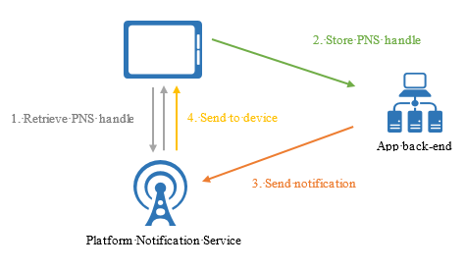
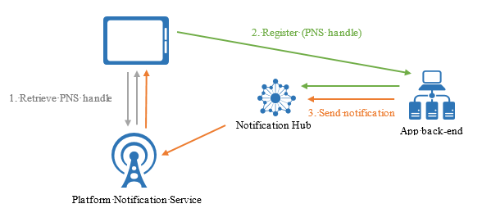
Notification Hub
Notification Hub handles many of the complexities
Notes:
Notes:
Notification Hubs eliminate complexity:
you do not have to manage the challenges of push notifications.
Instead, you use a Notification Hub.
Notification Hubs use a full multiplatform, scaled-out push notification infrastructure,
Considerably reduces the push-specific code that runs in the app backend.
Notification Hubs implement all the functionality of a push infrastructure.
Devices are only responsible for registering PNS handles, and the backend is responsible for sending platform-independent messages to users or interest groups
References:
https://azure.microsoft.com/en-us/documentation/articles/notification-hubs-overview/

Slide 13
Notification Hub
Seamless multi-platform support
Supports all major mobile platforms, including Android, iOS, and Windows Phone apps
Provides a common interface to send notifications to all the supported platforms
Platform specific protocols are not required
Maintains device handle registry and feedback from PNSs
Notes:
Notes:
The Notification Hub sits in between the app back-end and the PNS. It provides a common interface back to the app back-end while properly delivering the platform specific code to the PNS.
References:
https://azure.microsoft.com/en-us/documentation/articles/notification-hubs-overview/

Slide 14
Notification Hub
Provides multiple delivery patterns
Delivery Platform | Description
Broadcast | Allows near-simultaneous broadcast to millions of devices with a single API call
Unicast/Multicast | Push to tags representing individual users, including all of their devices
Segmentation | Push to complex segments defined by tag expressions
Notes:
Notes:
Example: Devices in San Francisco following the Warriors NBA finals
References:
https://azure.microsoft.com/en-us/documentation/articles/notification-hubs-overview/

Slide 15
Routing and Tag Expressions
Tags allow apps to send targeted notifications
A tag can be any string, up to 120 characters
“user_HenryPark”
“follows_Warriors”
As part of the registration management for device handles, tags can be registered with a particular device handle
Tag expressions are a Boolean expression on 1 or more tags
follows_Warriors && (location_San_Francisco || location_Oakland)
Notes:
Notes:
Tags can be associated for a device handle registered with Notification Hub
These tags can be used to create routing logic
Send notification to a single user on multiple devices (tag = user_HenryPark)
Send notification to Warrior fans in either San Francisco or Oakland
References:
https://azure.microsoft.com/en-us/documentation/articles/notification-hubs-overview/
https://azure.microsoft.com/en-us/documentation/articles/notification-hubs-routing-tag-expressions/

Slide 16
Notification Payloads
PNSs require a specific payload
To send an alert on APNS, the payload is a Json object:
{"aps": {"alert" : "Hello!" }}
Same toast message on Windows is
<toast> <visual>
<binding template=\"ToastText01\">
<text id=\"1\">Hello!</text>
</binding>
</visual> </toast>
Notes:
Notes:
Various platforms require different payloads for their push notification.
This means, developers need to produce different payloads for each platform
This requirements app developers to code for different platforms.
Developers coding for the presentation layer which is very painful
References:
https://azure.microsoft.com/en-us/documentation/articles/notification-hubs-overview/
https://azure.microsoft.com/en-us/documentation/articles/notification-hubs-templates/

Slide 17
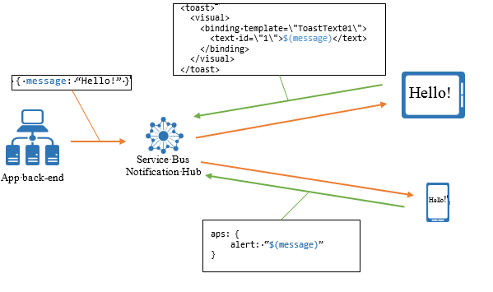
Notification Hub Template
Templates can be registered along with tags for each device
Notes:
Notes:
Client apps can register templates associated with a device
In the above example, the platform independent message is the actual alert itself (“Hello!”)
A template is a set of instructions for the Notification Hub on how to format a platform-independent message.
So the app back-end can now pass a platform-independent message {message:”Hello!”) and this will get translated to the platform specific payload
References:
https://azure.microsoft.com/en-us/documentation/articles/notification-hubs-overview/
https://azure.microsoft.com/en-us/documentation/articles/notification-hubs-templates/

Slide 18
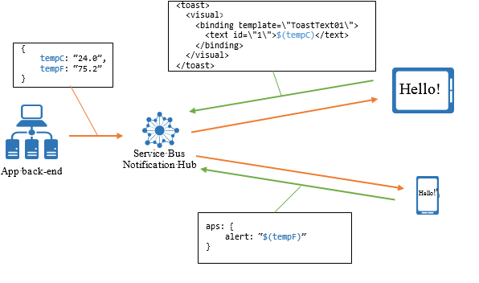
Notification Hub Template
Templates can also be used for personalized notification
Imagine a weather reporting client application
Users may want to personalize how they receive notification
Celsius or Farenheight
A 1-day forecast or 5-day forecast
Notes:
References:
https://azure.microsoft.com/en-us/documentation/articles/notification-hubs-overview/
https://azure.microsoft.com/en-us/documentation/articles/notification-hubs-templates/

Slide 19
Summary
In this lesson, you have learned:
What a push notification is
How Push Notification Systems operate
Challenges of these Push Notification Systems
How Azure Notification Hub attempts to overcome some of these challenges

